Slide 1

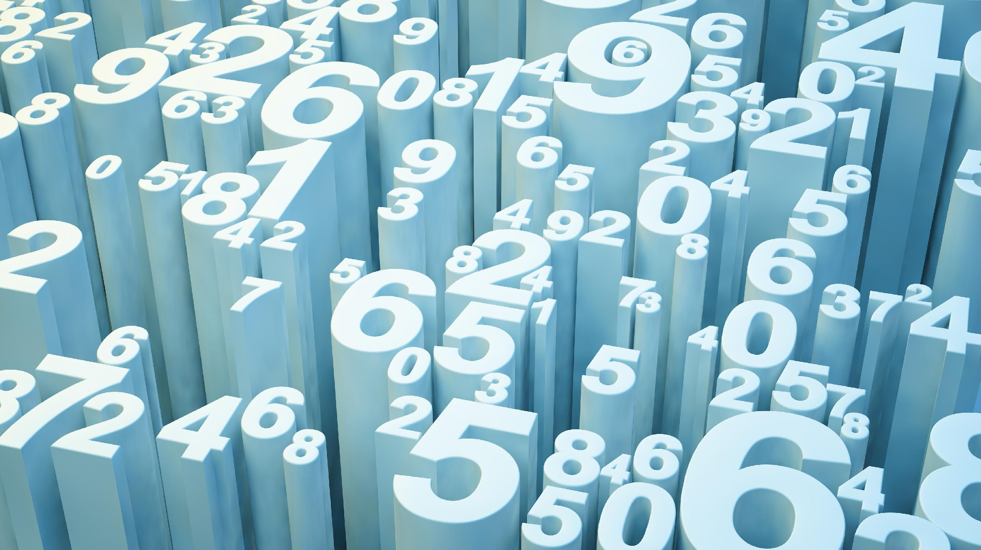
Smart AI Stock Trading System
AAI 590 – Capstone
Group 6
Javon Kitson, Nathan Metheny, Adam Graves

Slide 2
Introduction
AI Based Stock Trading System
A market of 23.74 billion in the next five years (Mordor Intelligence, n.d.)
Advancements in Deep Reinforcement Learning (DRL) fuel better performances
Applying a hybrid of DRL models to build an application

Slide 3

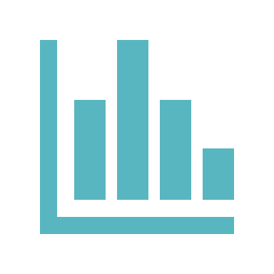

Key Discussions
The System
Performance
Results
Goals
Operations
Stakeholders
Technology
Data
Model Flow
AI Services
DRL Models
Scores
Trading Results
Compliance

Slide 4
Goals
Smart Stock Trading system for personal investments
AI Model driven trading decisions: Deep Reinforcement Learning (DRL) with RL models SAC and PPO.
Adhere to Compliance Regulations: Risk Tolerance

Slide 5
Operations
Software as a Service (SaaS): Web Based
Monthly Subscription fee
AI based stock trading decisions aligned with personal portfolio requirements
Performance Reporting Services

Slide 6
Stakeholders
Personal investment individuals that signed up for the service
Company Investors
System developers
Regulators: Mainly the SEC and FINRA

Slide 7
The Stock Trading Dataset
Purchased from First Rate Data: https://firstratedata.com/cb/4/complete-stocks-etf
Volume: 262GB
Unique Tickers: 10120 ~7k Stocks + ~3k ETFs
Portfolio Data from client-subscription input

Slide 8
Data ETL & EDA
Dataset Extract, Transform, & Load (ETL) services:
Data Cleaning
Data Transformation
Feature Engineering
Exploratory Data Analysis (EDA)
Analyze data fields
Check for data field correlations
Print results and visualization plots
Notes:
Our system begins by collecting the datasets from first rate data. This is followed by an Extract, Transform, and Load (ETL) process that ensures data integrity and usefulness. This includes:
Data Cleaning: Here, we scrub our data, remove duplicates, and ensuring consistency across our dataset.
Data Transformation: We manipulate the data to be completely numerical and convert the timestamp to datetime.
Feature Engineering: We then create new data points that enhance the model's predictive capabilities based on existing features.
Exploratory Data Analysis (EDA): This is where we dive into the dataset, analyzing fields for their distribution, checking for correlations, and preparing visual plots that will guide our model creation.
This process laid the groundwork for our trading algorithm by ensuring our data is not only clean but also insightful.

Slide 9
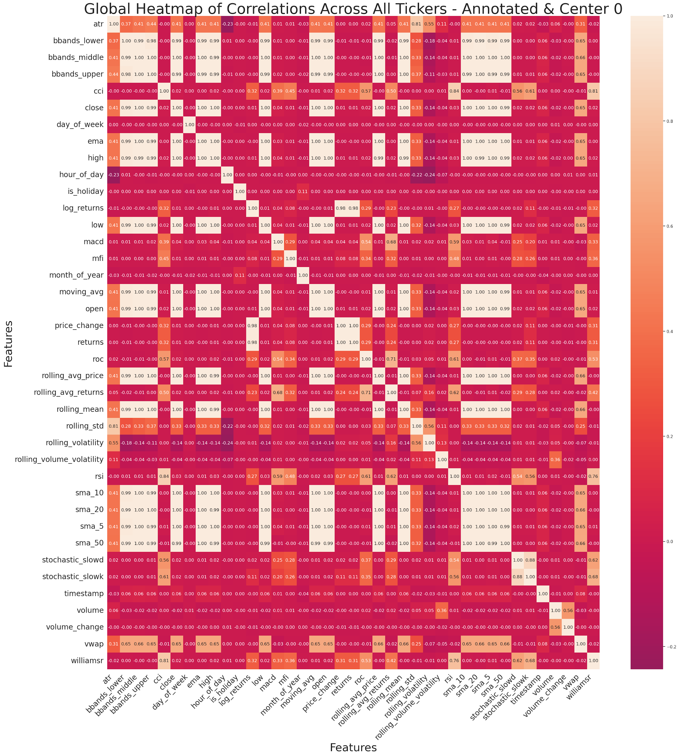
Field Correlations
Top Correlations
Boiler Bands
Lower
Middle
Upper
Simple Moving Average
5 Day
10 Day
20 Day
50 Day
Notes:
Here we have one of the images for correlations that are used in predicting stock movements:
Some of the Top Correlations, include:
Bollinger Bands: Indicators of volatility and price levels over time.
Lower Band: signaling oversold conditions.
Middle Band: the simple moving average, often a default setting for many traders.
Upper Band: indicating overbought conditions.
We also examine Simple Moving Averages (SMAs) for different periods:
5-day
10-day
20-day
50-day
These averages help us identify trends and potential pivot points in stock prices, which are crucial in making trading decisions.

Slide 10
Profile Data
Client Data input
Risk Tolerance calculation: Three Categories (Low, Med, High)
Pass the data to the Genetic Algorithm
Notes:
Moving on, we see how client data integrates into our system. We input client information and compute their Risk Tolerance using a tri-tiered categorization: Low, Medium, and High.
This calculated risk profile is then fed into our Genetic Algorithm, to optimize trading strategies. This ensures that our clients' investments align with their comfort levels and financial goals.

Slide 11
System Structure
Code Repository
Github
Data Repository
Athena Database and related tables
Data Processing
Model Training
Trade Engine

Slide 12
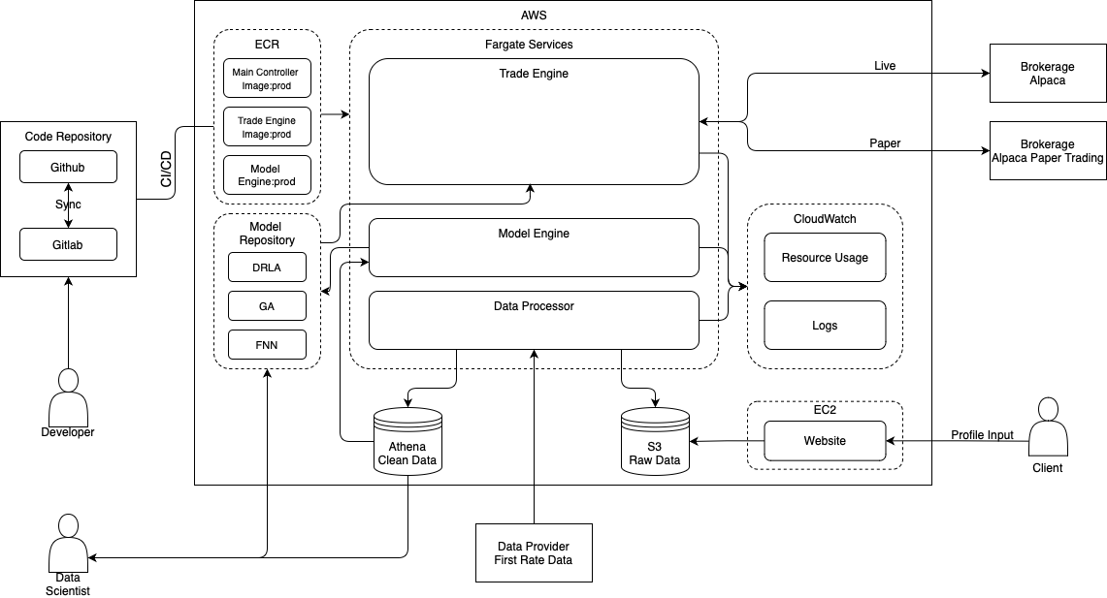
Data & Model Flow Diagram
Notes:
Here we have a diagram showing how our system is structured.

Slide 13
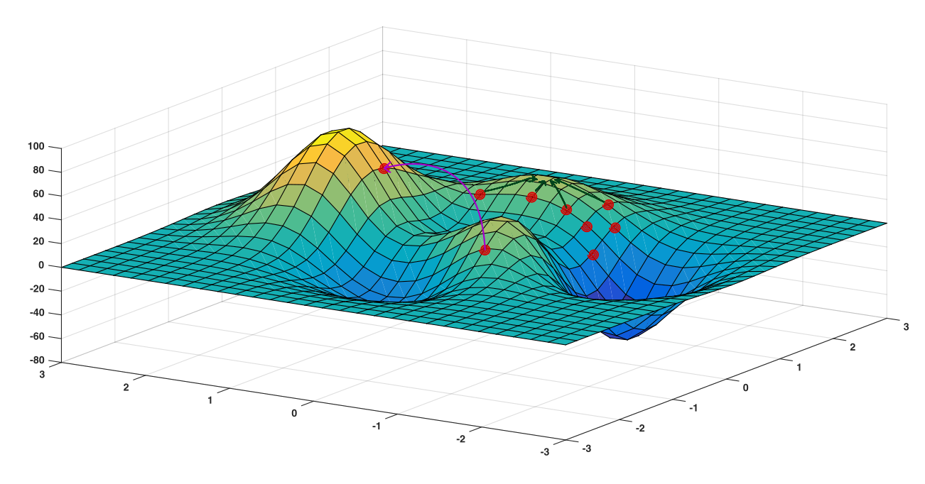
Genetic Algorithm (GA)
Genetic Algorithm (GA) for Portfolio Optimization:
Process: Mimics evolutionary selection to optimize portfolios
Objective: Tailors stock selection for goals like return maximization or drawdown minimization
Mechanism: Iteratively refines stock subsets for optimal performance
Adaptation: Evolves portfolios across generations for enhanced financial objectives
Integration: Outputs an optimized stock subset for DRL model input
https://ai.stackexchange.com/questions/8168/how-do-i-optimize-a-specific-function-using-a-genetic-algorithm [1]
Notes:
Our system begins with a Genetic Algorithm (GA) that set the stage for downstream Deep Reinforcement Learning agents. The GA serves as a search heuristic, emulating natural selection to optimize stock portfolio selections within a vast possibility space. It starts with a diverse initial population of portfolios, which are evolved through generations by selecting for fitness—defined by our goals of maximizing returns or minimizing risk via drawdown levels. This iterative process involves selecting the strongest portfolios, mixing their features to create offspring, and introducing random mutations, all aimed at refining the portfolio structure to align with our investment strategy.

Slide 14
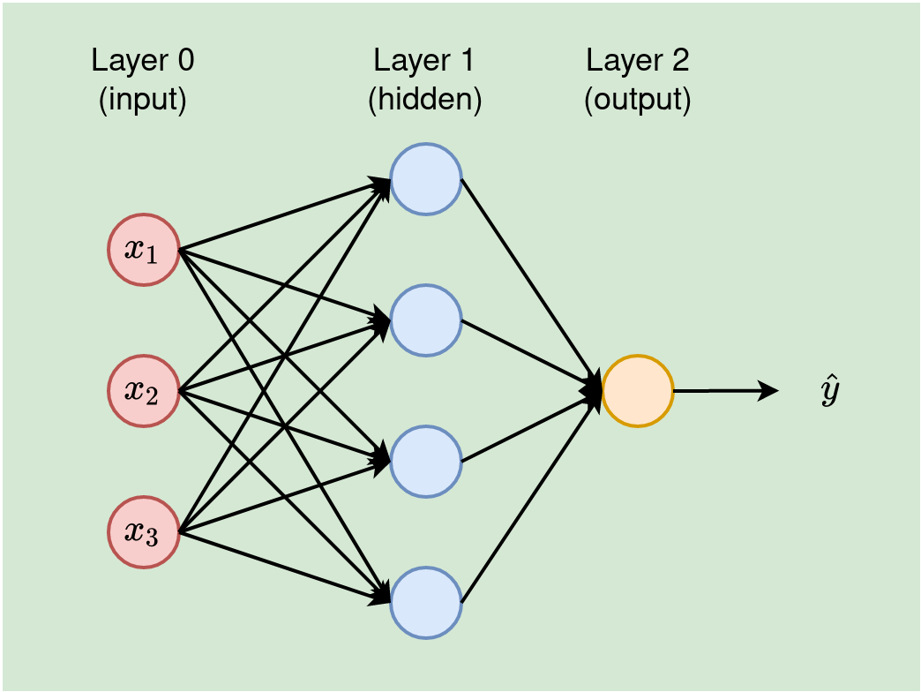
Feedforward Neural Network (FNN)
Feedforward Neural Network (FNN) for Price Prediction:
Purpose: Utilized for predicting future stock prices
Architecture: Multi-layered network processing time-series data
Function: Discerns patterns and trends to forecast prices
Training: Optimized using historical market data and backpropagation
Role in Strategy: Informs DRL models for data-driven trading decisions
https://www.google.com/url?sa=i&url=https%3A%2F%2Ftowardsdatascience.com%2Ffeed-forward-neural-network-with-example-neural-network-series-part-2 [2]
Notes:
The Feedforward Neural Network (FNN) in our system is designed for stock price prediction, utilizing an architecture that processes sequential data to identify patterns linked to future price movements. It features multiple layers of neurons, each detecting complex features in the data. During training, a loss function measures prediction accuracy, and backpropagation adjusts the network's weights to reduce errors. The FNN acts as a forecasting tool for our Deep Reinforcement trading algorithms, providing expected future prices. Its structure includes an input layer for raw or preprocessed data, multiple hidden layers with interconnected neurons using non-linear ReLU activations to model complex relationships, and an output layer that predicts future stock prices.

Slide 15
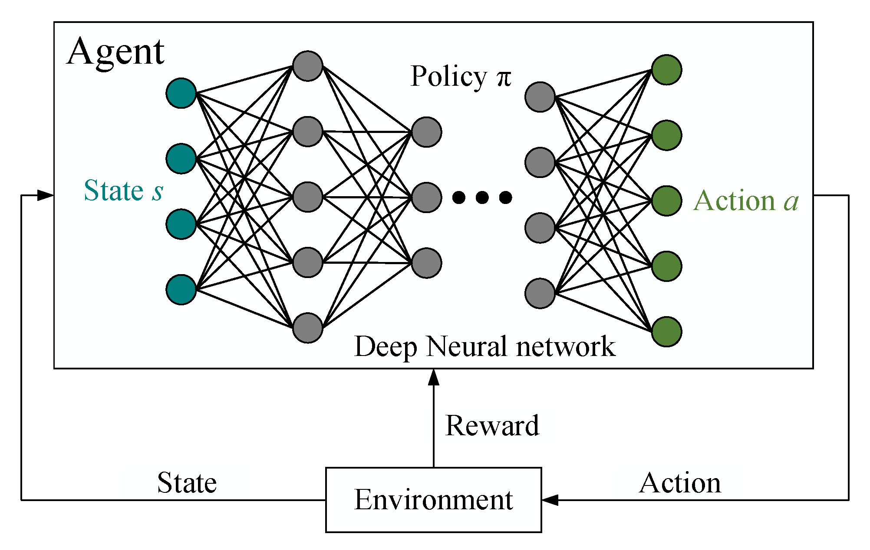
Deep Reinforcement Learning (DRL) Models
Deep Reinforcement Learning (DRL) for Trading Decisions:
Purpose: Learns optimal trade strategies via market interaction
Approach: Utilizes advanced algorithms to adapt and evolve trade actions
Algorithms: Incorporates SAC for efficient policy optimization and PPO for continuous policy improvement
Policy: Balances exploration and exploitation to maximize investment rewards
Outcome: Aims to outperform traditional trading methods with adaptive, data-informed decisions
https://www.google.com/url?sa=i&url=https%3A%2F%2Fwww.mdpi.com% [3]
Notes:
The DRL models, Soft Actor-Critic (SAC) and Proximal Policy Optimization (PPO), are central to our trading strategy, learning from a simulated market and a portfolio optimized for risk and return. SAC, an off-policy model, enhances sample efficiency by learning from both new and existing data, optimizing policies through entropy maximization for better exploration. PPO, an on-policy method, updates policies using a surrogate objective to balance policy exploration and conservative updates, preventing performance collapse. Both models are fine-tuned for stock market volatility, aiming to outperform traditional and machine learning-based strategies.

Slide 16
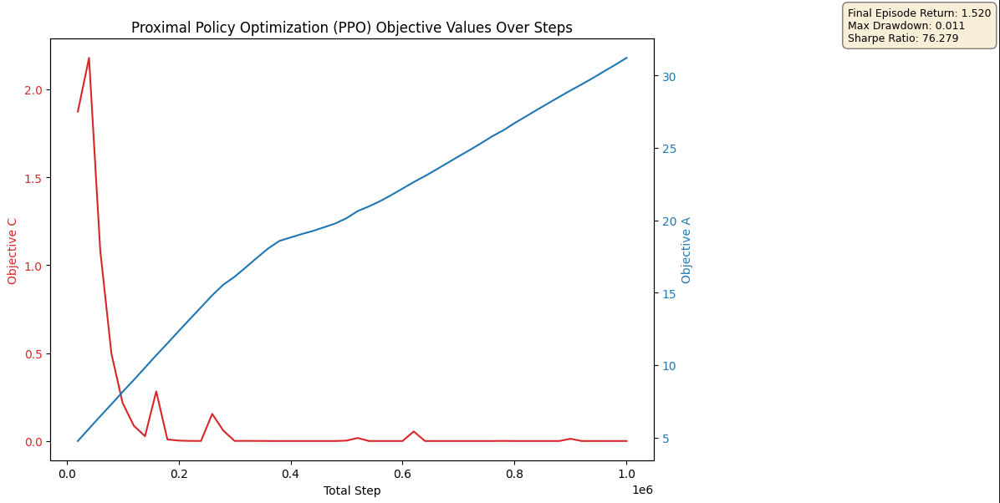
Performance / Results
System Performance and Results:
Sharpe Ratio: 76.3 - Indicates robust excess returns compared to the risk-free rate
Maximum Drawdown: 0.011 - Reflects the ability to limit losses in adverse market conditions
Cumulative Returns: 1.52 - Aligns with our goal to maximize returns
FNN Accuracy: r² at 0.993, RMSE at 0.085 - Shows the precision of our predictions relative to actual price movements
Overall Assessment: The system's overall performance surpasses our benchmarks, showcasing that our integrated approach holds considerable promise
Notes:
Both the SAC and PPO algorithms showed effective trading strategies; SAC yielded an 89% ROI compared to PPO's 52% on validation data, with SAC excelling in learning speed and adaptability, while PPO offered higher stability and a slightly superior Sharpe ratio, indicating a more balanced risk-return profile.
Moving to the FNN, its predictive accuracy is quantified by a r-squared (R^2) of 0.993, and a Root Mean Squared Error (RMSE) of 0.085. These metrics are critical as they reflect the precision of our predictions relative to actual price movements.
To conclude, our system's overall performance surpasses our benchmarks, showcasing that our integrated approach holds considerable promise. Our ongoing efforts are directed at further refining the models to boost future performance metrics.

Slide 17
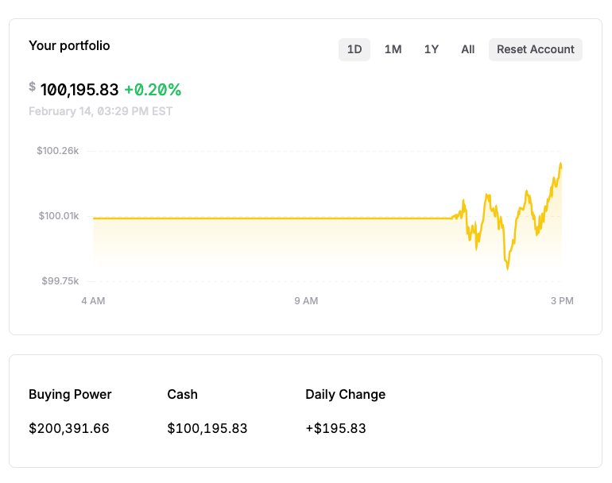
Deployment
Deployment Strategy Overview
Trigger and Deployment:
Lambda Function: Activates upon model registration in SageMaker, initiating deployment.
AWS Fargate: Deploys model in a serverless container environment, removing the need for server management.
Scaling and Configuration:
Dynamic Resources: Configures and scales resources within Fargate based on trading volume and market conditions.
Endpoint and Integration:
Endpoint Setup: Establishes a container endpoint in Fargate for model access.
Alpaca API: Connects to Alpaca for trade execution based on model insights.
Monitoring and Adjustment:
AWS Tools: Monitors performance, ensuring system reliability and quick adjustments.
Key Benefits:
Flexibility: Adapts to market demands without fixed infrastructure.
Efficiency: Reduces overhead with automated scaling and management.
Notes:
Our deployment strategy leverages AWS Lambda and Fargate, automating model deployment upon SageMaker registry to a serverless container for enhanced scalability and reduced manual management. This dynamic system adapts to trading volumes, integrates with Alpaca's API, and is continuously monitored for optimal performance and swift market response.

Slide 18
Future Versions
Future Versions: System Enhancements
Hyperparameter Optimization: Implementing Bayesian optimization for efficient hyperparameter tuning in DRL models.
Extended Training: Increasing the breadth and depth of DRL agent training for robust performance in diverse market conditions.
Adaptive Learning Rates: Employing dynamic learning rates to adjust model training responsiveness to market volatility.
Reward Shaping: Refining reward structures to better guide DRL agents towards profitable trading behaviors.
Early Stopping Mechanisms: Integrating callbacks to prevent overfitting, ensuring models generalize well to unseen data.
Anticipated Outcomes:
Precision: Enhanced accuracy in predicting market movements and executing trade strategies.
Adaptability: Improved model resilience to sudden market changes and anomalies.
Performance: Superior financial results through advanced model training and optimization techniques.
Notes:
In the next generation of our system, we're focusing on two primary areas: further improvements to our models and extensive training to capture more nuanced market patterns.
One major upgrade is the implementation of a more sophisticated method for searching the Deep Reinforcement Learning (DRL) hyperparameter space. We plan to employ Bayesian optimization techniques, which allow us to systematically and intelligently navigate the hyperparameter landscape. This method relies on probabilistic models to predict which hyperparameters are likely to yield better performance, reducing the need for extensive trial-and-error and saving valuable computational resources.
Additionally, we're increasing the amount of training for our DRL agents. More training on a wider variety of market scenarios will equip our models with the experience necessary to handle unexpected market movements and volatility. We aim to utilize adaptive learning rates and reward shaping to fine-tune our models' responses to shifting market dynamics.

Slide 19
Project Contributions
Adam Graves
Client Data Input and Risk Calculation
Developed the interface for client data input, capturing essential metrics for personalized portfolio construction.
Implemented the risk tolerance calculation algorithm, categorizing clients into Low, Medium, and High risk categories based on their profiles and preferences.
Analysis and Reporting
Managed project documentation and contributed to writing the final research paper.
Leadership and Project Management
Provided project oversight, ensuring milestones were met and resources were efficiently utilized.
Coordinated between team members to facilitate seamless integration of various project components.
Nathan Metheny
Model Development and Training
Designed and implemented the Feedforward Neural Network and Genetic Algorithm architecture.
Developed the Deep Reinforcement Learning models, including SAC and PPO algorithms.
Optimization and Testing
Optimized DRL model hyperparameters and reward functions.
Conducted back-testing to validate model effectiveness and adjust trading strategies.
Analyzed model performance metrics and developed charting.
Model Deployment
Developed model deployment to AWS and Alpaca
Analysis and Reporting
Managed project documentation and contributed to writing the final research paper.
Javon Kitson
Data Collection and Preprocessing
Led the effort to gather and clean historical stock data, ensuring a robust dataset for model training.
Developed scripts for automated data augmentation and feature engineering.
Analysis and Reporting
Created and managed project diagrams
Cloud Resources
Managed cloud resources on AWS

Slide 20
Citations
[1] Evan PkEvan Pk 2933 bronze badges, Alvin SartorAlvin Sartor 9155 silver badges1010 bronze badges, & nbronbro 40.5k1212 gold badges106106 silver badges193193 bronze badges. (1964b, July 1). How do I optimize a specific function using a genetic algorithm?. Artificial Intelligence Stack Exchange. https://ai.stackexchange.com/questions/8168/how-do-i-optimize-a-specific-function-using-a-genetic-algorithm
[2] Koech, K. E. (2022, May 30). How neural network works - with worked example (neural network series) - part 2. Medium. https://towardsdatascience.com/feed-forward-neural-network-with-example-neural-network-series-part-2-eeca7a081ef5
[3] Yi, J., & Liu, X. (2023, August 21). Deep reinforcement learning for intelligent penetration testing path design. MDPI. https://www.mdpi.com/2076-3417/13/16/9467

